Slide 1

Optimal train rescheduling after conflict detection
Sofie Van Thielen, Sofie Burggraeve,
Pieter Vansteenwegen
KU Leuven, Leuven Mobility Research Centre – CIB
Sofie.VanThielen@kuleuven.be

Slide 2
Contents
Motivation
Problem description
Scope of this work
Strategies
Results
Conclusion & further work

Slide 3

Motivation
Normal situation:
Conflict:
Notes:
How primary delay leads to secondary delays

Slide 4
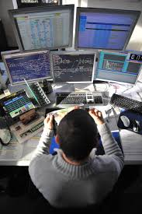
Motivation
In practice:
Real-time management is performed manually.

Slide 5
Real-time traffic management
Train movement prediction
Conflict detection
Conflict resolution
Decision Support System

Slide 6
Problem description
Given one (or more) conflicts, present different good solutions with the corresponding total delay.
In a tool that is directly accessible for the dispatchers.

Slide 7
Scope of this work
Star-shaped network
Both freight and passenger trains
Only small perturbations
Conflict resolution: only rescheduling (retiming and reordering)

Slide 8
Strategies
First Come, First Serve (FCFS)
A
B
A
B

Slide 9
2) Priority to Type of Train (PTT)
  Every train has a type name, which characterises the speed and stopping pattern.
  Least amount of stops and high speed → highest type
  Assumption: economic cost of delaying freight train < economic cost of delaying passengers
A
B

Slide 10
  If a conflict occurs, then the train with the highest type gets preference.
THA
L
THA
L

Slide 11
3) Conflict limitation (CL)
  Minimising the effect of conflicts
  Based on examining the progress during the next hour
  Consider both options and choose the train that induces the least total delay
A
B

Slide 12
Step 1a: train A first
A
B
A
C

Slide 13
Step 1b: progress of train B
A
B
B
C

Slide 14
Step 1c: effect of train A on train B
A
B
B
A

Slide 15
Step 2a: train B first
A
B
B
C

Slide 16
Step 2b: progress of train A
A
B
A
B
D

Slide 17
Step 2c: effect of train B on train A
A
B
A
B

Slide 18
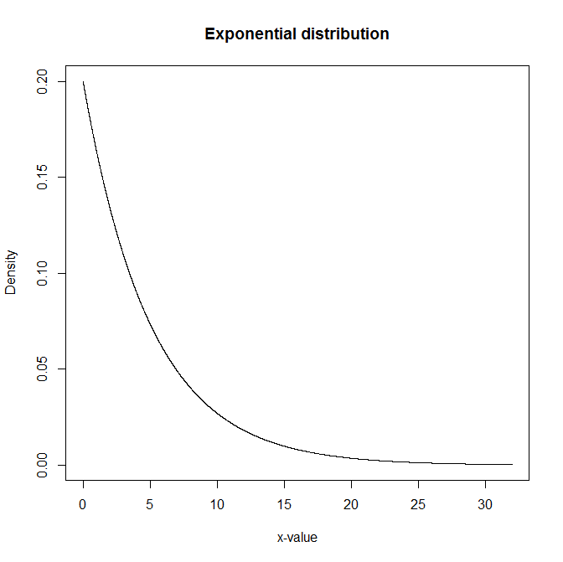
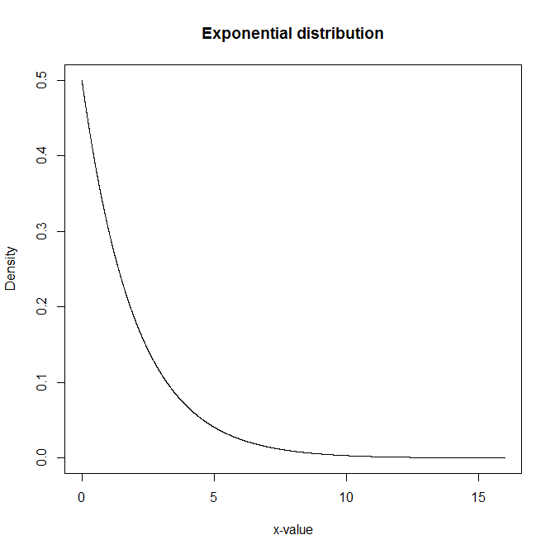
Simulation
2-hour window: 7-9 AM
82 trains
Delay scenarios
Study area

Slide 19

Study area
Brugge-Gent-Denderleeuw (in Belgium)
Brugge
Oostende
Denderleeuw
Gent

Slide 20
Further improvements
Prevent ‘deadlock’ situations
Increase entrance delays

Slide 21
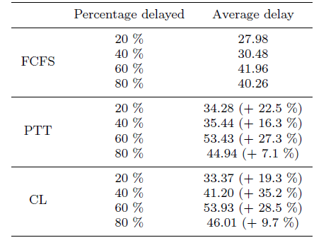
Preliminary results

Slide 22
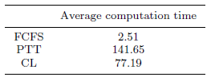
Computation time

Slide 23
Further improvements (CL)
Consider total delay instead of conflict duration
Also consider the effect of train A on B (and vice versa)
B
A

Slide 24
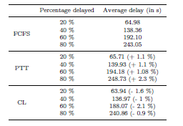
Results

Slide 25

Computation time

Slide 26
Conclusion & further work
Simulation – based on actual data from Infrabel – works well.
Decide on the time window to consider.
Include more trains → create more conflicts
Include rerouting options → even only in station areas this will give good solutions.

Slide 27

Questions?

Slide 28
Optimal train rescheduling after conflict detection
Sofie Van Thielen, Sofie Burggraeve,
Pieter Vansteenwegen
KU Leuven, Leuven Mobility Research Centre – CIB
Sofie.VanThielen@kuleuven.be

